Slide 1
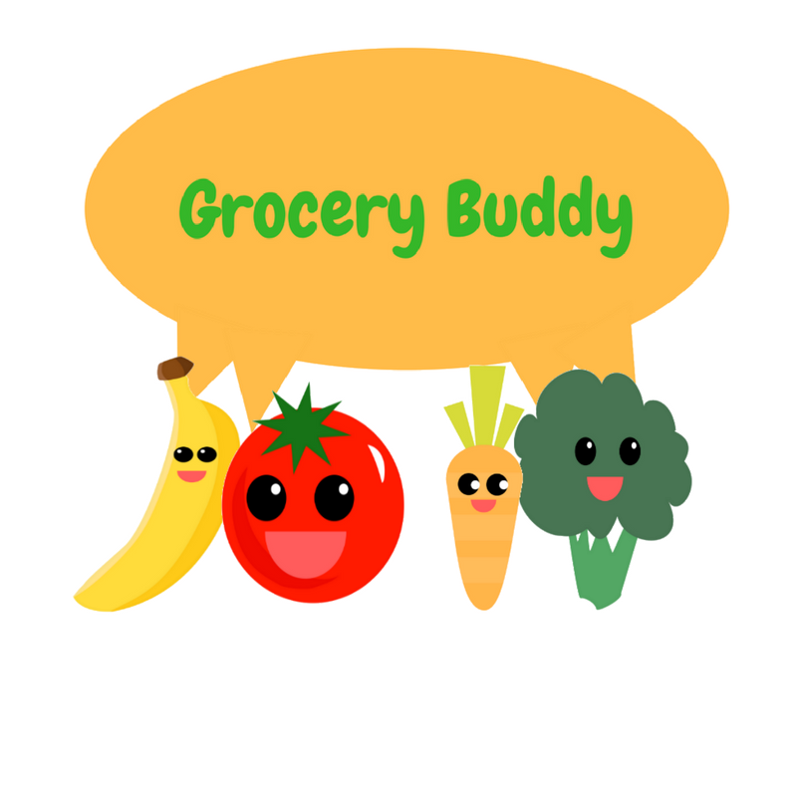
Grocery Buddy
By Ecoders (Patrick, Raly, Kevin, Toni, and Carlo)

Slide 2



What Does It Do?
“Make the most of out what you have”
Plan what you buy – Grocery Lists
Make sure you use it – Fridge expiry trackers and notifications

Slide 3


What went well:
We had a plan.
We met target goals.
We added important features.
And some extras.
Caffeine consumption-- ☺
Lessons learned.
Improved efficiency.

Slide 4




What didn’t go so well:
Stress ☹
Team members got sick ☹
Practically living at school.
No time for anything else.
Endless bug fixing and testing

Slide 5

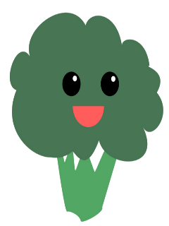
Workflow adjustments:
Team members must remember to document work done on scrumboard.
That’s all.

Slide 6

App Showcase:
Alt+Tab!

Slide 7


Conclusion
THANKS!

